Slide 1
JanVayu जनवायु
#aqiforjanhit
MMSF Air Quality Initiative
India's Citizen-Led Air Quality Archive
A permanent public archive ensuring India's air pollution crisis is never reset to zero — documenting live data, health impacts, economic costs, and holding authorities accountable.
ACTION
ACCOUNTABILITY
CHANGE
Live AQI monitoring, health calculators, safe outdoor hours, citizen guides
Promise tracker, RTI templates, court orders, budget monitor
Policy recommendations, global success stories, citizen voices archive
1.72M
$339B
5.3 yrs
17%
Deaths/Year (Lancet 2025)
9.5% GDP (World Bank)
Life Lost Delhi (AQLI)
NCAP Funds Used (RTI)
Because clean air is not a privilege, it's a right.
www.janvayu.in

Slide 2
Inside the Platform
janvayu.in
Live Dashboard
ALL FEATURES
Live AQI from 20+ cities
Interactive pollution map
5-year historical trends
Personal health calculator
Economic loss estimator
GRAP stage tracker
RTI templates and guide
Court orders database
Citizen voices archive
247
156
68
Delhi
Mumbai
Bangalore
Health Risk Calculator
+23%
2.8 yrs
8.5
Mortality Risk
Life-Years Lost
Cigarettes/Day
Accountability Tracker
Delhi NCAP fund utilization: 17% only
NCAP PM2.5 reduction: 25-27% achieved
Govt claim on deaths: Contradicts Lancet
Data Sources
WAQI API, CPCB, Lancet, WHO, World Bank, CREA, RTI
Open Source (MIT) | github.com/Varnasr/JanVayu | v12.1
Explore at janvayu.in

Slide 3
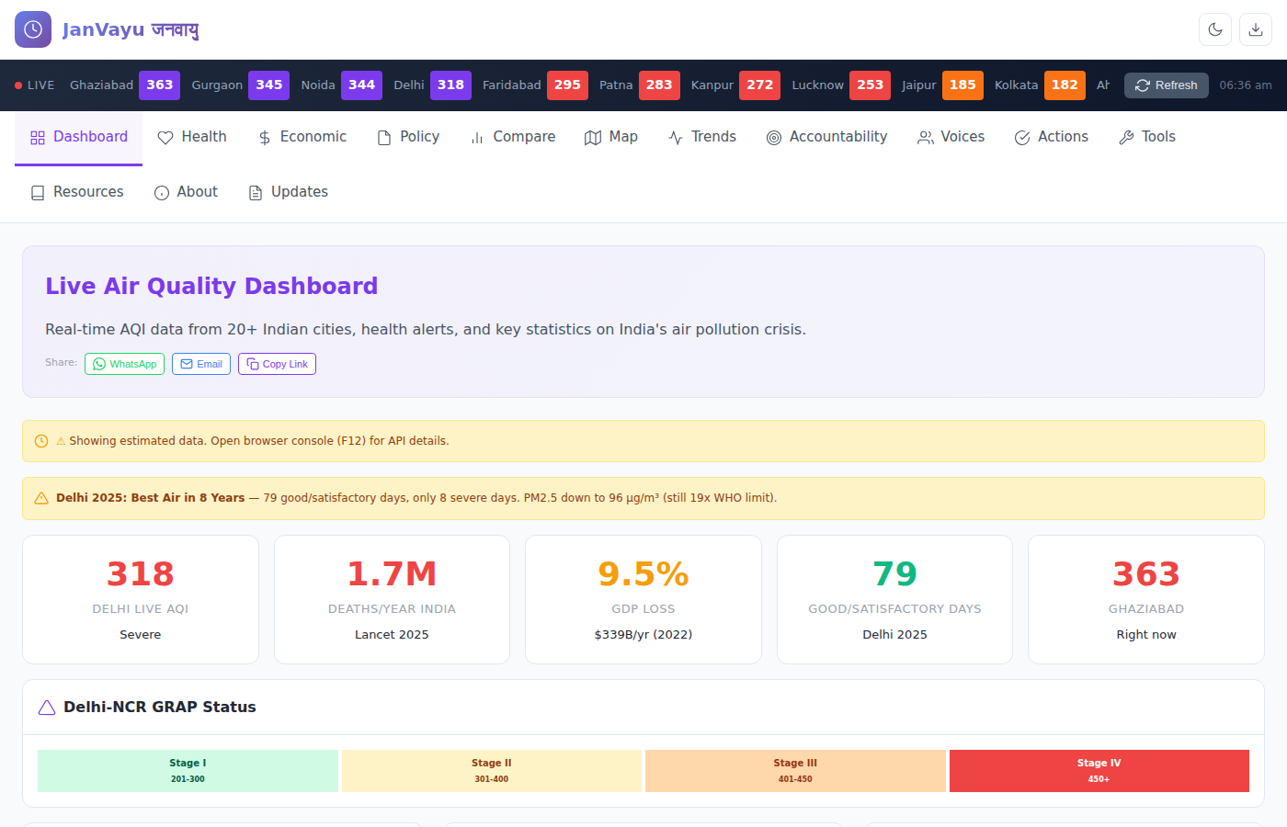
Platform Tour: Live Dashboard
janvayu.in
Real-time AQI
Live pollution data from 20+ Indian cities updated every hour via WAQI API
Key Statistics
1.7M annual deaths (Lancet 2025), 9.5% GDP loss ($339B), Delhi life expectancy impact
GRAP Tracker
Current Delhi-NCR emergency response stage with color-coded thresholds (I-IV)
News Alerts
Breaking air quality news, government announcements, and Delhi 2025 progress updates

Slide 4
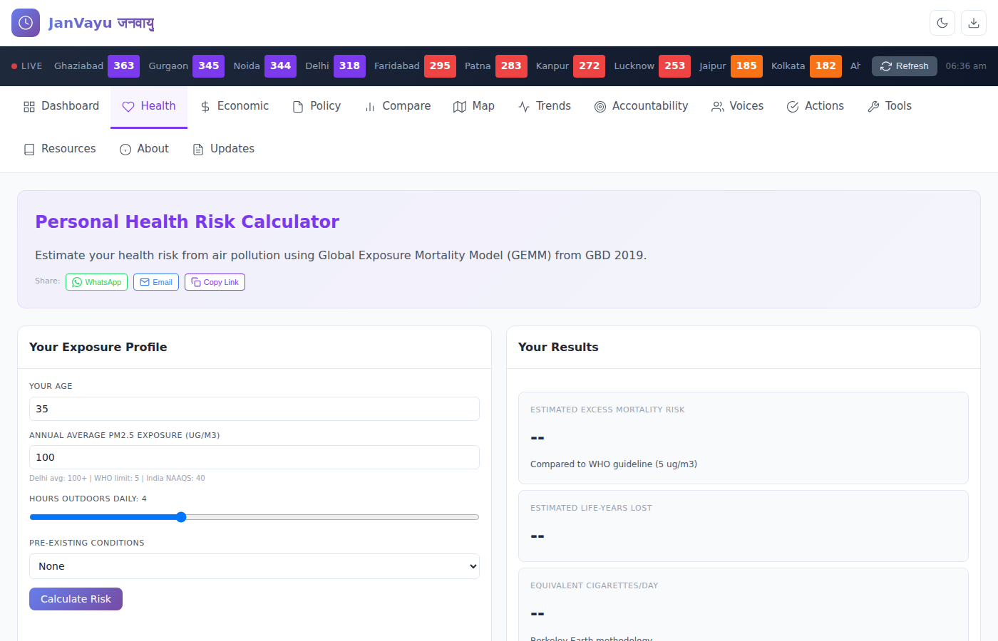
Personal Health Risk Calculator
janvayu.in
GEMM Model
Uses Global Exposure Mortality Model from Lancet GBD 2019 — the gold standard for PM2.5 health impact
Mortality Risk
Calculates your excess mortality risk compared to WHO guideline (5 µg/m³)
Life-Years Lost
Estimates years of life expectancy lost based on your exposure profile
Cigarette Equivalence
Translates daily pollution exposure into equivalent cigarettes smoked (Berkeley Earth method)

Slide 5
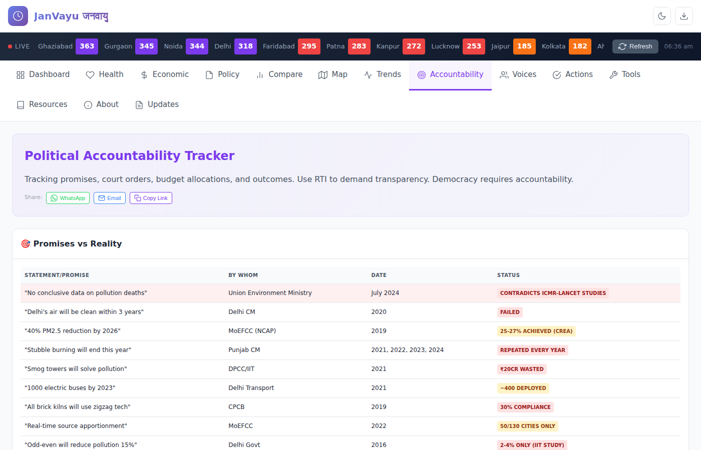
Political Accountability Tracker
janvayu.in
Promises vs Reality
Tracks government claims against actual outcomes with color-coded status badges
Court Orders
Database of Supreme Court and NGT orders with compliance tracking
RTI Templates
Ready-to-use RTI applications for pollution data, fund utilization, and compliance reports
Budget Monitor
NCAP fund allocation vs utilization — only 17% used in Delhi (RTI 2025)

Slide 6
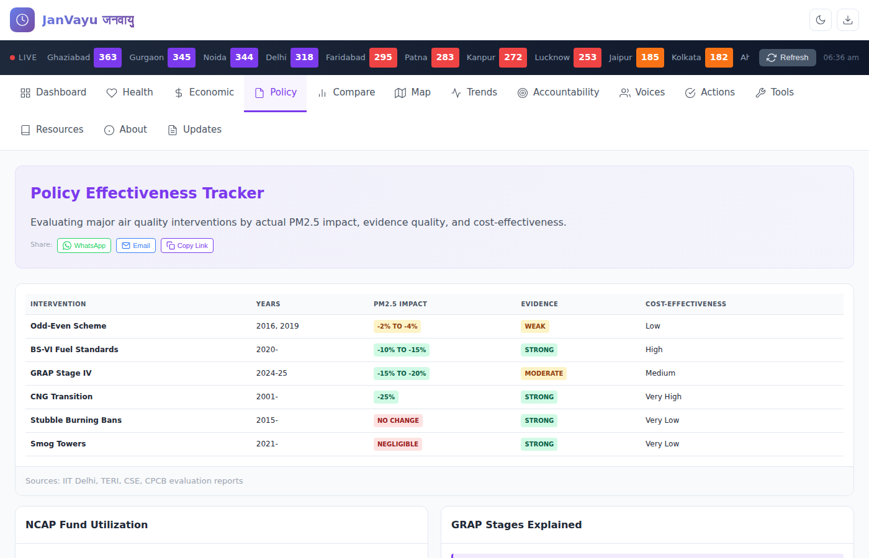
Policy Effectiveness Tracker
janvayu.in
Evidence Grades
Each intervention rated by research quality: Strong, Moderate, or Weak evidence
PM2.5 Impact
Actual pollution reduction measured by peer-reviewed studies (IIT Delhi, TERI, CSE)
Cost-Effectiveness
Compares interventions by cost per µg/m³ reduction — CNG transition ranked 'Very High'
NCAP Progress
Tracks 40% reduction target — currently at 25-27% (CREA 2024)

Slide 7
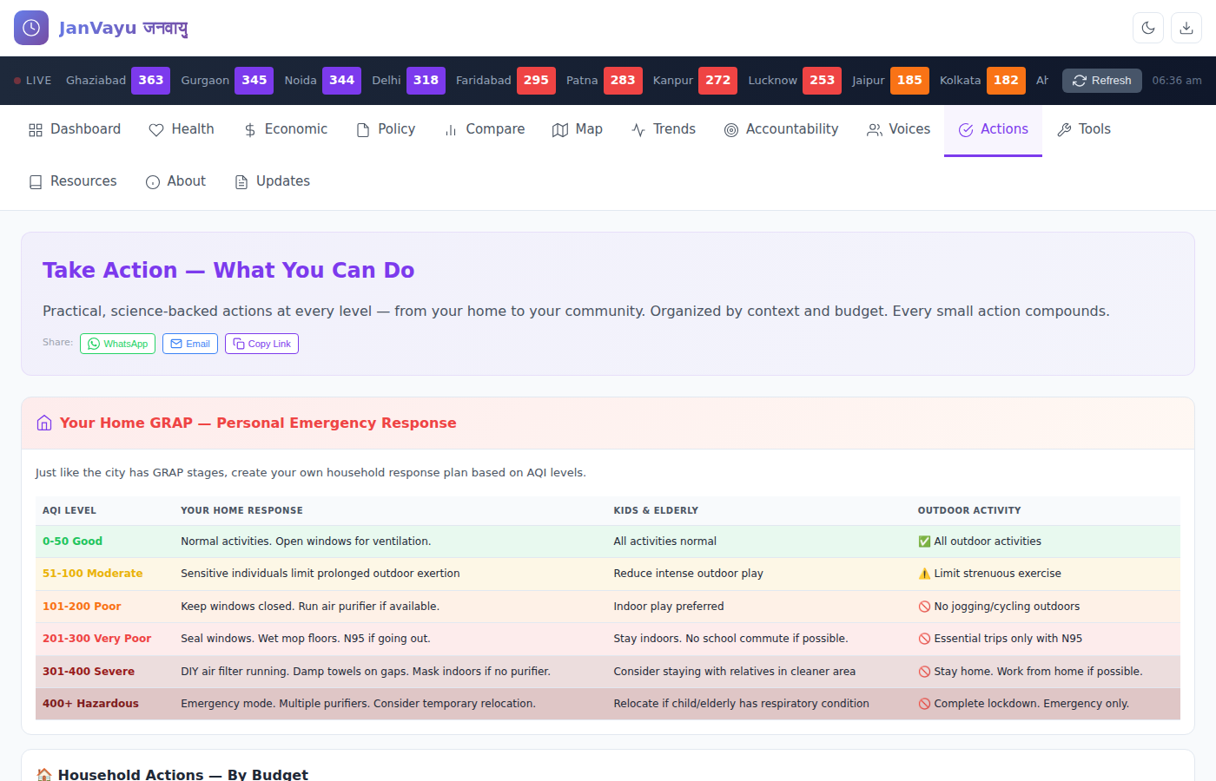
Take Action — What You Can Do
janvayu.in
Personal GRAP
Your own emergency response plan tied to AQI levels — like the city's GRAP but for your home
Budget Actions
Household interventions organized by cost: ₹0 (wet mopping) to ₹15K+ (air purifiers)
Vulnerable Groups
Specific guidance for children, elderly, and those with respiratory conditions
Community Tools
Letter templates, complaint portals, and citizen advocacy resources

Slide 8
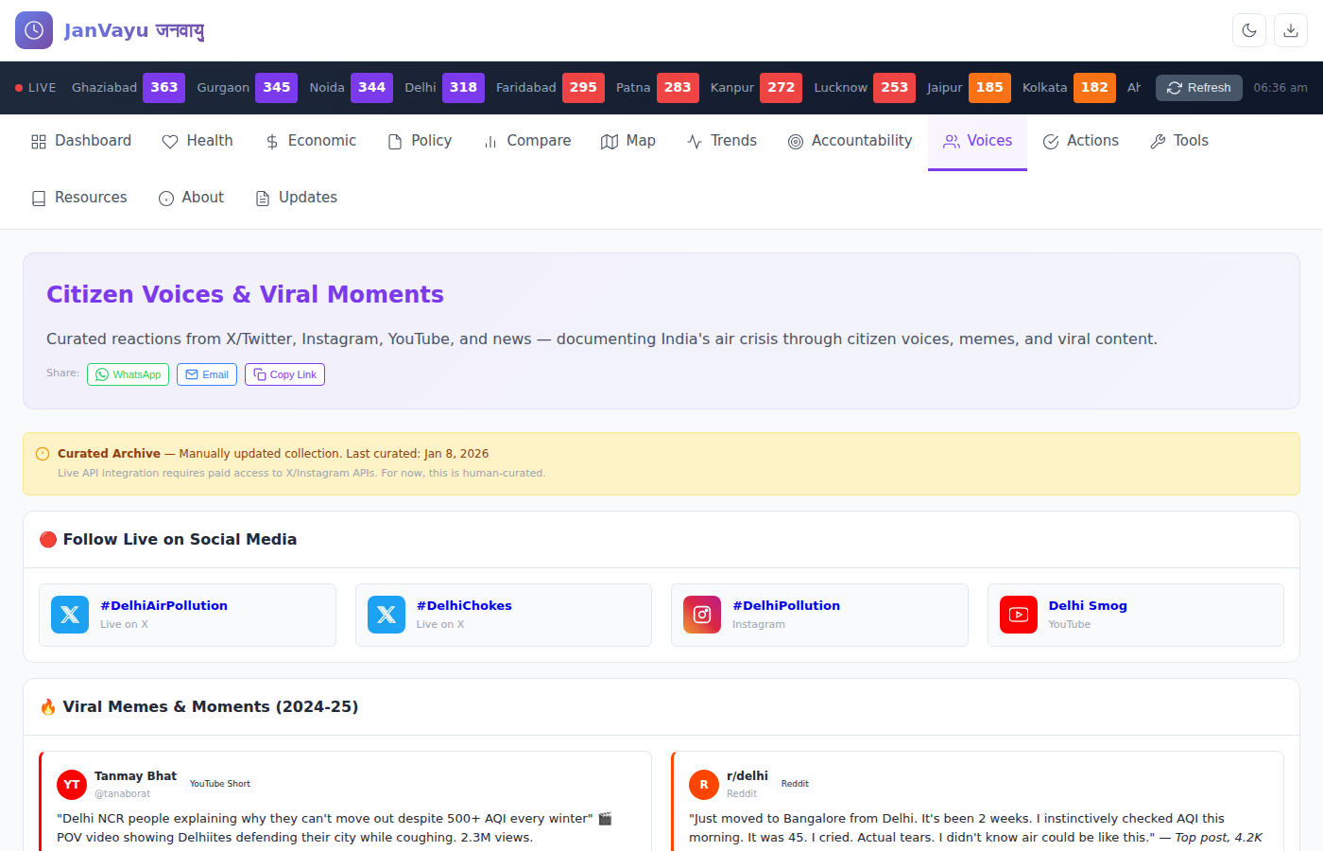
Citizen Voices & Viral Moments
janvayu.in
Live Hashtags
#DelhiAirPollution, #DelhiChokes — real-time social media feeds from X and Instagram
Viral Archive
Curated memes and moments that shaped public discourse (Tanmay Bhat's 2.3M view video)
Reddit Community
r/delhi posts documenting citizen experiences and emotional impact
Cultural Memory
Preserving how Indians respond to the crisis through humor and solidarity

Slide 9
JanVayu: Key Takeaways
ACTION
ACCOUNTABILITY
CHANGE
• Live AQI from 20+ cities
• Personal health risk calculator
• GRAP stage tracker
• Safe outdoor hours guide
• Promises vs Reality tracker
• Court orders database
• RTI templates ready to use
• Budget utilization monitor
• Evidence-based policy ratings
• Citizen voices archive
• Community advocacy tools
• Open source (MIT license)
The Crisis in Numbers
1.72M deaths/year (Lancet 2025) • $339B economic loss (9.5% GDP) • 5.3 years life lost in Delhi • 17% NCAP funds utilized
www.janvayu.in • github.com/Varnasr/JanVayu • #aqiforjanhit

Slide 10
Thank You
Questions & Discussion
Because clean air is not a privilege, it's a right.
www.janvayu.in
github.com/Varnasr/JanVayu • #aqiforjanhit
MMSF Air Quality Initiative

